Slide 1
The National Armored Cable Manufacturers Association Presents
Installation Standard for Types AC and MC Cables

Slide 2
An ANSI Standard
Original document jointly produced by NECA and NACMA as “Standard for Installing Armored Cable (AC) and Metal-Clad Cable (MC)” NECA/NACMA 120-2013

Slide 3
Session Outline
1. Scope
2. Glossary
3. Identification of Cables
4. Armored Cable (Type AC)
5. Metal-Clad Cables (Type MC)
6. General Installation Procedures

Slide 4
Session Outline
7. AC Cables—Specific Installation Procedures
8. MC Cables—Specific Installation Procedures
9. Type MC Cables in Hazardous (Classified) Locations

Slide 5
1. Scope
This document covers the selection and installation of Type AC and Type MC cables.
It also includes information on fittings.
This document is intended to enhance electrical safety by:
Ensuring that the proper cable is selected for the installation.
Describing proper installation methods for Type AC and MC cables
Aiding installers in meeting the “Neat and Workmanlike” requirements of the NEC
Creating an installation that will protect the wire conductors from mechanical abuse

Slide 6
1. Scope (continued)
All information in this publication is intended to comply with the National Electrical Code (NFPA 70). Installers should always follow the NEC, applicable state and local codes, and manufacturers’ instructions when installing electrical products and systems.
Only qualified persons as defined in the NEC should install cables. Administrative functions can be performed under the supervision of a qualified person

Slide 7
2. Glossary
Fire-stopping
Fire-rated Assemblies
Fishing
Homerun
Through-Penetration Fire Stop Systems
(It is not intended to repeat definitions from the NEC.)

Slide 8
3. Identification of Cables
3.1 Identification
Type MC of the interlocked armor type and AC cables may look similar on their exterior (Figure 3.1).
It is important that the proper cable be selected for installations where specific construction features or performance requirements are desired or are required in the NEC. Specific uses permitted and not permitted are identified in the following sections of this standard. Consult Table 1 for assistance in identifying cables.

Slide 9
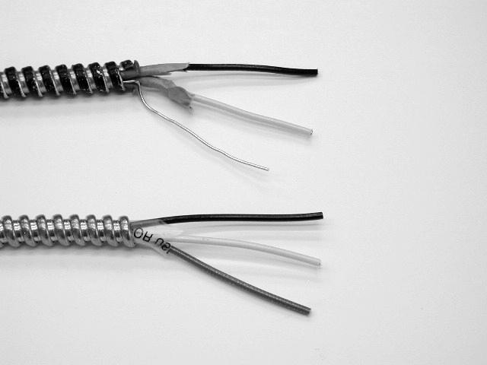
Type AC Cable
Type MC Cable

Slide 10
Table 1: Identification of Type AC and MC Cables
 | Type AC Cable | Interlocked Armor Type MC Cable | Interlocked Armor Type MC Cable with Armor/Bond (MCI-A)
Number of Conductors | No more than 4 plus EGC. | No limit | No limit
Size of Conductors | 14 AWG to 1 AWG | 18 AWG to 2000 kcmil | 14 AWG – 6 AWG

Slide 11
Table 1: Identification of Type AC and MC Cables (continued)
 | Type AC Cable | Interlocked Armor Type MC Cable | Interlocked Armor Type MC Cable with Armor/Bond (MCI-A)
Equipment Grounding | Has 16 AWG bond wire in constant contact with metal armor. Bond wire and armor together = EGC. | No bonding wire. The armor is not itself an EG. Internal EGC with armor = ground-fault path. | Includes full size aluminum grounding/ bonding conductor. Bond wire with armor = EGC.

Slide 12
Table 1: Identification of Type AC and MC Cables (continued)
 | Type AC Cable
Cable Construction | Individual conductors are wrapped in a moisture resistant, fire retardant paper. Individual conductors with thermoset insulation do not require the paper wrap, the wrap must be applied to the entire assembly.

Slide 13
Table 1: Identification of Type AC and MC Cables (continued)
 | Interlocked Armor Type MC Cable
Cable Construction | A protective covering over the individual conductors may be provided. Conductor assembly may have overall nonmetallic wrap under the armor.

Slide 14
Table 1: Identification of Type AC and MC Cables (continued)
 | Interlocked Armor Type MC Cable with Armor/Bond (MCI-A)
Cable Construction | Protective covering over the individual insulated or jacketed conductors may be provided. Conductor assembly may have overall nonmetallic wrap under the armor.

Slide 15
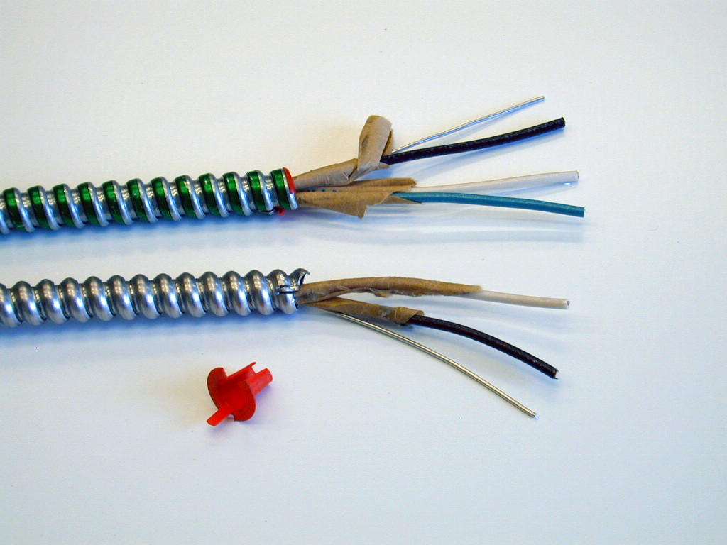
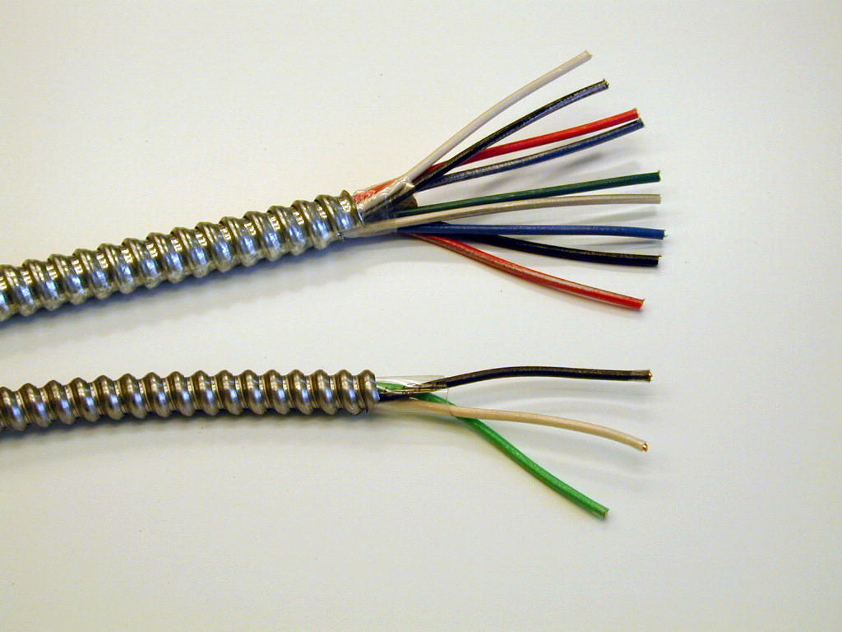
Type AC Cable
Type MC Cable

Slide 16
4.1 Description, Type AC Cable
A factory assembly of insulated conductors protected in an overall flexible metallic armor (sheath).
Metallic sheath may be of aluminum or steel.
Armored cable having an aluminum sheath is suitable for use in alternating current circuits only.

Slide 17
4.1 Description, Type AC Cable (continued)
Permitted have 2 to 4 conductors in sizes 14 through 1 AWG copper with or without an equipment grounding conductor
All conductors with thermoplastic insulated conductors have an individual moisture-resistant fiber wrap and are cabled together in the manufacturing process.
Typical branch circuit cable has copper conductors with THHN insulation in Type ACTHH.

Slide 18
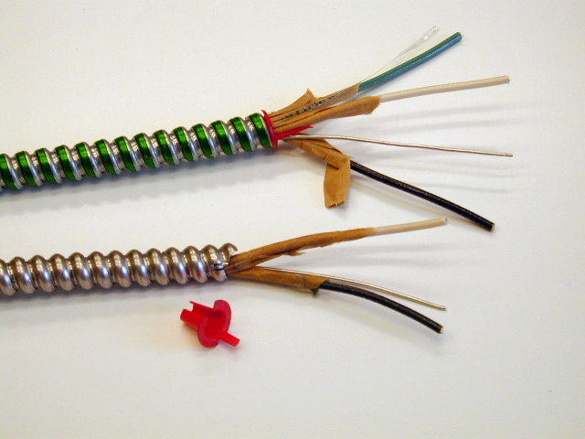
Type AC Cable, Construction

Slide 19
4.2 Equipment Grounding, Type AC Cable
A bare 16 AWG aluminum bonding strip is inside of and in intimate contact with the cable armor for full length of cable
Outer armor with bonding strip is acceptable as an equipment grounding conductor
Some AC cable has an insulated equipment grounding conductor. These cables are permitted in patient care areas of health care facilities and for isolated equipment grounding conductor installation

Slide 20
4.3 Uses Permitted, Type AC Cable
Where not subject to physical damage: | Without insulated equipment grounding conductor | With insulated equipment grounding conductor
In both exposed and concealed work | Yes | Yes
See Pages 6 and 7 for other Uses Permitted

Slide 21
4.3.1 Uses Permitted, Special Occupancies
Where not subject to physical damage: | Without insulated equipment grounding conductor | With insulated equipment grounding conductor
In Class I, Division 2 areas for nonincindive field wiring | Yes | Yes
See Pages 6 and 7 for other Uses Permitted, Special Occupancies

Slide 22
4.4 Uses Not Permitted, Type AC Cable
As service-entrance conductors
Where subject to physical damage unless protected by conduit or tubing
In damp or wet locations (see Article 100)
In air voids of masonry block or tile walls where such walls are subject to excessive moisture or dampness
Where exposed to corrosive conditions
Embedded in plaster finish on brick or other masonry in damp or wet locations

Slide 23
4.5 Connectors
AC cable connectors. Fittings for connecting Type AC cable are required to be marked as suitable for such use. The identification is either on the smallest container in which the product is packaged or is on the connector itself.
Select the appropriate size of connector for the trade size of the cable. Some connectors are suitable for connecting two cables.

Slide 24
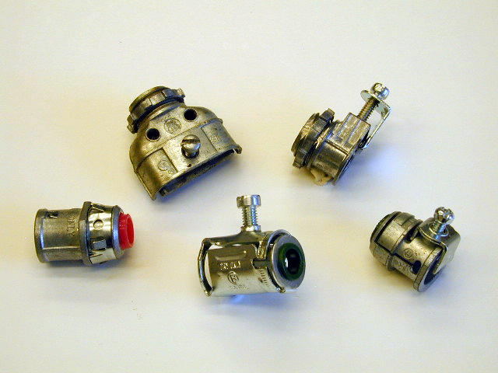

Slide 25
4.5 Connectors (continued)
AC cable set-screw connectors. Connectors of the set-screw type are only permitted to be used with cables having steel armor. They are not acceptable on cables with aluminum armor.

Slide 26
4.5 Connectors (continued)
Other connectors. Connectors for Type MC cable and power and control tray cable are also suitable for use with Type AC cable when specifically indicated on the connector or the shipping carton.

Slide 27
4.5 Connectors (continued)
Insulating bushings. Connectors or clamps that connect Type AC cable to boxes or cabinets are designed so the required insulating bushing is visible for inspection after the cable is connected. The insulating bushing is often referred to in trade jargon as a “red head.”

Slide 28
4.5 Connectors (continued)
Grounding. All listed connectors for Type AC cable are suitable for grounding since the armor of Type AC cable serves as the equipment grounding conductor. Remove paint or other insulating material between the enclosure and the connector to ensure a proper grounding connection.

Slide 29
More on Fittings for Type AC Cable
See UL White or Green book (AWSX) for additional information.

Slide 30
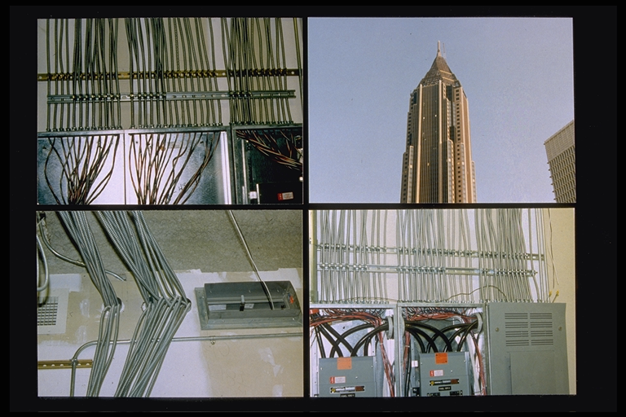
5. Metal-Clad Cables (Type MC)

Slide 31
5.1 Description
Type MC cable is a factory assembly of one or more insulated current-carrying conductors and one or more equipment grounding conductors (if required) in an overall metallic sheath. MC cable is manufactured with three different types of armor in the following configurations:

Slide 32
5.1 Description (continued)
Interlocking metal-tape (steel or aluminum) – (MCI)
Interlocking metal-tape (steel or aluminum) – Armor ground (MCI-A)
Smooth metal tube (aluminum only) – (MCS)
Corrugated metal tube (copper or aluminum) – (MCC)

Slide 33
5.1 Description (continued)
MC cable consists of one or more current-carrying conductors, one or more equipment grounding conductors if required, and in some cases optical fibers. MC cables containing optical fibers are designated Type MC-OF and are considered composite cables in accordance with NEC Article 770.

Slide 34
5.2 Conductors
Branch circuits, Feeders and Services. MC cable contains conductors from 18 AWG through 2000 kcmil for copper and 12 AWG through 2000 kcmil for aluminum. Typical branch circuit Type MC cables have copper conductors with THHN, THHN/THWN/THWN-2 or XHHW/XHHW-2 insulation and are suitable for circuits up to 600 volts.

Slide 35
5.2 Conductors (continued)
Typical feeder and service Type MC cables have aluminum or copper conductors with THHN/THWN-2 or XHHW/XHHW-2 insulation and are suitable for circuits up to 600 volts.

Slide 36
5.2 Conductors (continued)
Medium voltage. Type MV cables are available with conductor insulations rated from 2,400 to 35,000 volts and may be marked for use as Type MC cables.
Fire alarm. Type MC cables intended for fire alarm/control applications have TFN, TFFN, THHN or other suitable insulation.

Slide 37
5.3 Special MC Cable Configurations
Fire Alarm
Composite Cable
Oversize neutral conductors
Multiple individual neutral conductors
Homerun
PVC jacketed cable

Slide 38
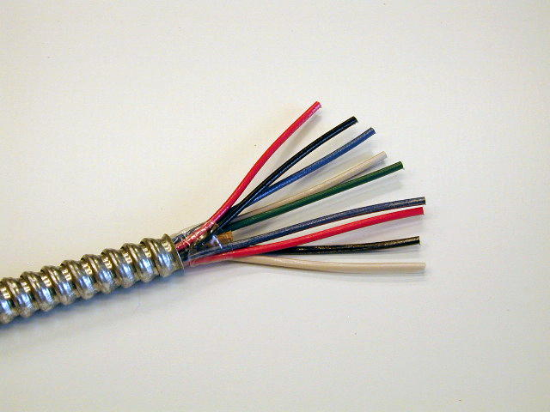
Multiple Neutral Conductors

Slide 39
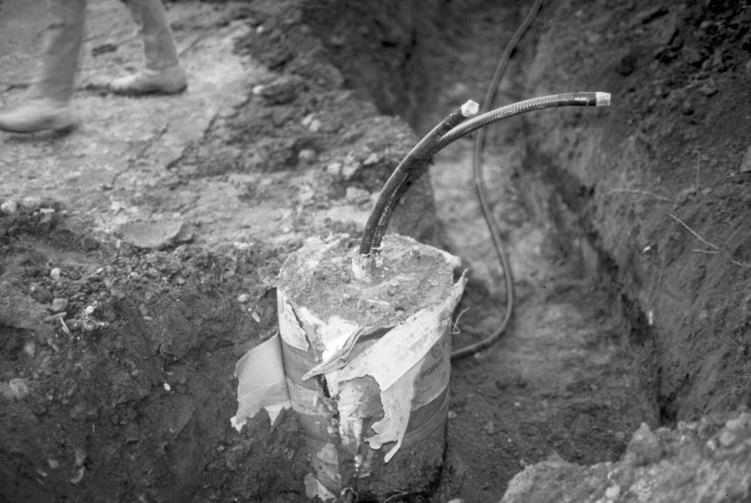
PVC Jacketed Cable

Slide 40
5.4 Equipment Grounding
5.4.1 Interlocking Metal Tape Sheath
The armor of Type MC Cable with an interlocking metal tape sheath is not itself suitable as an equipment grounding conductor. The cable includes an equipment grounding conductor which is either bare or insulated. For branch-circuit sizes, the most common type of equipment grounding conductor is insulated with an unstriped (solid) green color.

Slide 41
5.4.1 Equipment Grounding (continued)
Sectioned (larger feeder sizes)
Multiple smaller equipment grounding conductors are installed to equal the size otherwise required in UL-1569
Isolated ground MC cables
have an additional equipment grounding conductor . Marked “IG”

Slide 42
5.4.1 Equipment Grounding (continued)
Patient care areas. The outer armor of the interlocked metal sheath Type MC cable (MCI) is not permitted as an equipment grounding conductor. This type is not permitted as the wiring method in patient care areas of health care facilities.
Type MC cable with an interlocked metal sheath and bare aluminum grounding/bonding conductor (MCI-A) is permitted as the wiring method on the normal source in patient care areas of health care facilities.

Slide 43
5.4.2 Smooth or Corrugated Sheath Type MC Cable
The armor of MC cables with smooth or corrugated sheaths, or a combination of the sheath and a supplemental bare or unstriped green insulated conductor, is suitable for use as an equipment grounding conductor.
Bare equipment grounding conductor or green insulation without a stripe.
Green insulated equipment grounding conductor with a yellow stripe.

Slide 44
5.5 Uses Permitted
Where not subject to physical damage, Type MC cable is permitted to be installed as follows: | Comments:
For services | Comply with Article 230
For feeders | Comply with Articles 215 or 225
For branch circuits | Comply with applicable NEC article
See pages 11-13 for other Uses Permitted

Slide 45
5.6 Uses Not Permitted
Type MC cable is not permitted to be installed: | Comments:
Where exposed to corrosive fumes or vapors | Is permitted where the metallic sheath is suitable for the conditions … such as a PVC jacket
Directly buried in the earth | Is permitted if overall jacketed cable is listed and marked for direct burial
See page 13 for other Uses Not Permitted

Slide 46
5.7 Connectors
5.7.1. Criterion for Selecting
The range of cable diameters and type of sheath
Material of the sheath (aluminum, copper, steel or polymeric jacket)
“Concrete-tight …”
“For Type MC Cable”
“Dry locations …”
“Wet locations …”

Slide 47
5.7.2 Connector Identification
The identification is either on the connector itself or the smallest container in which the product is packaged.
Connectors for Type MC cable, and for power and control tray cable, are also suitable for use with Type AC cable when specifically indicated on the connector or shipping carton.

Slide 48
Table 5.7.2, Identification of Connector
Type of Metal-Clad Cable | Abbreviation
Metal-clad interlocking armor | MCI
Metal-clad interlocking armor ground cable | MCI-A
Metal-clad continuous smooth sheath armor cable | MCS
Metal-clad continuous corrugated sheath armor cable | MCC
Metal-clad continuous corrugated sheath armor cable, flat | FLAT

Slide 49
5.7.2 Connector Identification (continued)
Connectors for Type MC cable, and for power and control tray cable, are also suitable for use with Type AC cable when specifically indicated on the connector or shipping carton.

Slide 50
5.7.3 Connector Size
Select the appropriate size of cable connector for the dimension of the cable.
The size of cable the connector is designed to terminate may be marked on the shipping carton.
For some applications of jacketed Type MC cables, the diameter over the jacket must be considered
Connectors are available for connecting two cables to one knockout.

Slide 51
5.7.4 Suitable for Type of Cable or Location
Direct bearing set-screw connectors are suitable for only steel armor
Aluminum connectors are suitable for only aluminum cables unless marked otherwise. Aluminum connectors are not permitted in concrete or cinder fill unless protected

Slide 52
5.7.4 Suitable for Type of Cable or Location (continued)
Concrete-tight connectors should be used to secure PVC-jacketed MC cable embedded in concrete to boxes or other enclosures where the connections are covered in concrete
Some connectors are suitable for use on Jacketed Type MC cable only when taped. The packaging for these connectors will be marked “Concrete tight when taped when used with jacketed aluminum Type MC cable and jacketed steel Type MC cable.”
Wet-location connectors must be used for cable connections in wet locations

Slide 53
5.7.5 Grounding
Listed connectors for use with metal-clad interlocking armor ground cable (MCI-A) corrugated aluminum or copper tube or smooth tube cable are suitable for grounding in circuits over and under 250 volts since the outer armor of these types of Type MC cable serves as the equipment grounding conductor.
Remove paint or other insulating material between the enclosure and the connector to ensure a proper grounding connection.

Slide 54
6. General Installation Procedures
6.1 General Procedures
In addition to complying with the specific installation requirements of the NEC, Type AC and Type MC cables are required to be installed in a “neat and workmanlike manner.” To the extent practicable, visible cables should be installed in vertical or horizontal lines or otherwise follow building lines. Cables must be supported properly where they are routed around obstacles as they are inherently flexible (Figure 6.1).

Slide 55
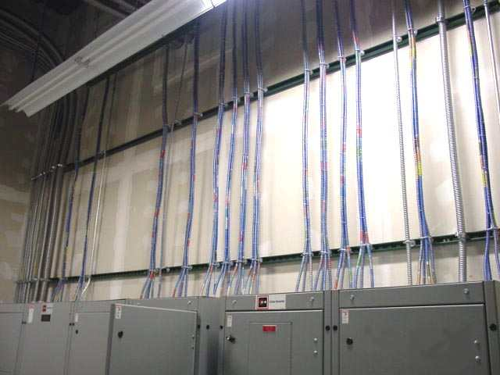

Slide 56
6.1 General Procedures
Condition | Type AC Cable | Type MC Cable
Exposed work according to the following three conditions: | Unless otherwise permitted, closely follow the surface of the building finish or running boards. | Install in a neat and workmanlike manner.
See pages 16-18 for other General Installation Procedures

Slide 57
6.2 Installation of Home Runs
6.2.1 Planning
6.2.2 Home Run Cables
6.2.3 Phasing of Circuit Conductors
6.2.4 Application of Adjustment Factors
6.2.4.1 When the Neutral Counts as current-carrying

Slide 58
6.2.1 Planning
Where panelboards are located in spaces where future access may be difficult, install spare cables to an accessible location.
Identify locations by tags or other means.

Slide 59
6.2.2 Home Run Cables
Available in a variety of conductors
3-wires with ground
4-wires with ground
8-wires with ground
12-wires with ground
16-wires with ground

Slide 60
6.2.3 Phasing of Circuit Conductors
Connect multi-wire circuits properly in panelboards, junction boxes and at outlets
One ungrounded conductor per phase and a common neutral

Slide 61
6.2.4 Derating Conductors
Table 6.2.4 (Table 310.15(B)(2)(a) in the NEC) generally applies where the current-carrying conductors in cables exceeds 3 and the cables are bundled longer than 24 inches without maintaining spacing.

Slide 62
Table 6.2.4: Ampacity Reduction
No. of Conductors | Percent of Ampacity
4-6 | 80
7-9 | 70
10-20 | 50
21-30 | 45
31-40 | 40
41 and above | 35

Slide 63
6.2.4 Derating Conductors
Derating of Type AC and MC cables is not required where:
Each cable has not more than 3 current-carrying conductors
The circuit conductors are 12 AWG copper
Not more than 20 current-carrying conductors are bundled, stacked or supported on bridle rings
60 percent derating applies where more then 20 current-carrying conductors

Slide 64
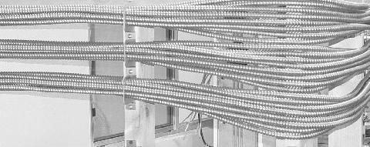
Figure 6.2.4 Cable Supporter

Slide 65
Issues Related to Derating for Number of Conductors
Determine the number of current-carrying conductors in branch circuits
When do we have to count neutrals as current-carrying? [310.15(B)(5)]
Apply rules of Table 310.15(B)(2)(a) when required
Begin ampacity adjustment from 90 degree C column in Table 310.15(B)(16) (THHN conductors in dry location)

Slide 66
Home Run Cable Example 1
8, 3-wire cables are installed longer than 24 in. and the neutral conductors are not considered to be current-carrying
Derating is not required as the installation has 16 current-carrying conductors

Slide 67
Home Run Cable Example 2
8, 4-wire cables are bundled longer than 24 in. and the neutral conductors count as current-carrying
Consider as 32 current-carrying conductors
Apply adjustment factor from 310.15(B)(3)(a)(5)
60 percent (30 x .6 = 18 amperes)
Allowable ampacity is 18 amperes.

Slide 68
6.2.4.1 When the Neutral Counts
When do we count the neutral?
310.15(B)(5)(a). Don’t have to count if it carries only the unbalance from other conductors
310.15(B)(5)(b). Have to count in a 3-wire circuit from 4-wire, 3-phase wye system
310.15(B)(5)(c). Have to count on 4-wire, 3-phase circuit where major portion of the load is nonlinear

Slide 69
6.3. Cutting AC and MC Cables
6.3.1 Rotary Armor Cutter
6.3.2 Hacksaw
6.3.3 Wire Cutters
6.3.4 Caution

Slide 70
6.3.1 Rotary Armor Cutter
Designed specifically for safely cutting AC and MC cable armor
Select appropriate rotary cutting tool
Adjust anvil
Cut armor
Slide armor off cable

Slide 71
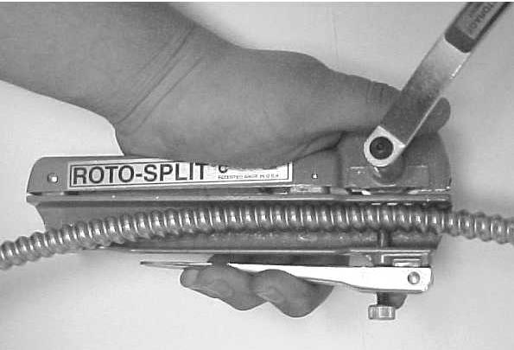

Slide 72
6.3.2 Hacksaw
Cutting the armor of Type AC and MC cables with a hacksaw is not recommended
Insulated conductors can be easily damaged

Slide 73
6.3.3 Wire Cutters
Cutting the armor of Type AC and MC cables by “breaking” and use of diagonal pliers, tin snips or similar tool is not recommended
Insulated conductors can be easily damaged

Slide 74
6.3.4 Caution
Protect person’s hands from sharp edges
Protect insulated conductors from any sharp edge left from cutting operation

Slide 75
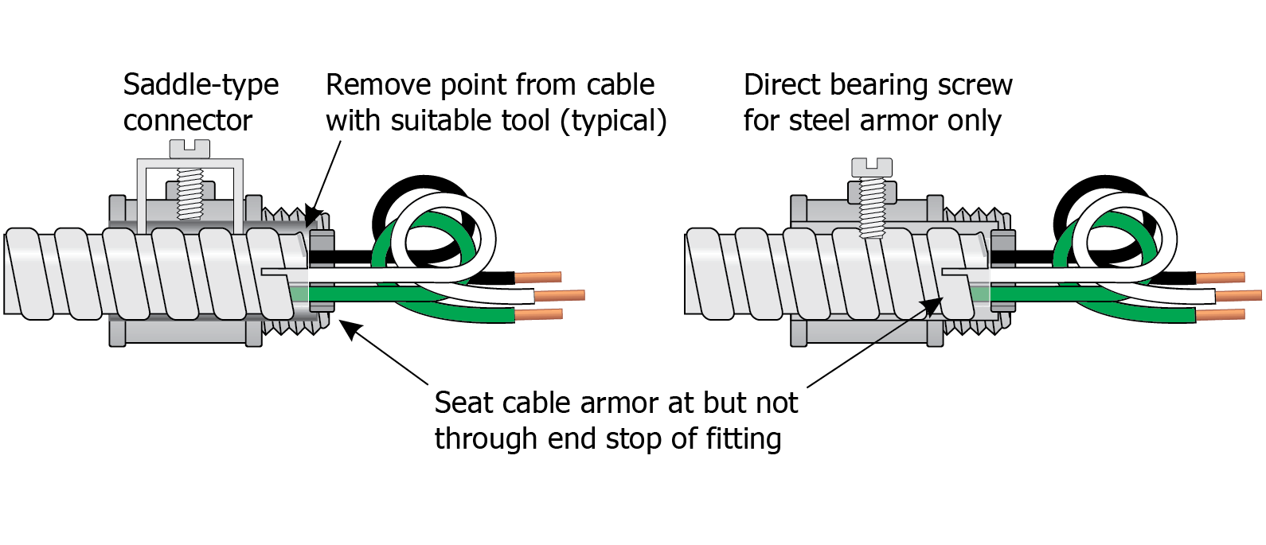
6.4 Position of Cable in Connector

Slide 76
6.5.1 Overcurrent Protection and Derating Type AC Cables
Generally, select ampacity from Table 310.15(B)(16)
Other rules include:
Overcurrent protection of small conductors in 240.4(D)
Derating where more than 3 current carrying conductors are bundled (see 20-conductor exception)

Slide 77
Table 6.5.1 OCP & Derating of Type AC Cables
Size | 90°C Amps | Small Cndtr | ≤ 20 wires | > 20 wires | Therm Ins
14 | 25 | 15 | — | — | 20
12 | 30 | 20 | 30 | 18 | 25
10 | 40 | 30 | — | — | 30

Slide 78
6.5.2 Type MC Cables
Generally, select ampacity from Table 310.15(B)(16)
Other rules include:
Overcurrent protection of small conductors in 240.4(D)
Derating where more than 3 current carrying conductors are bundled (see 20-conductor exception)

Slide 79
Table 6.5.2 OCP & Derating of Type MC Cables
Size | 90°C Amps | Small Cndtr | ≤ 20 wires | > 20 wires
14 | 25 | 15 | — | —
12 | 30 | 20 | 30 | 18
10 | 40 | 30 | — | —

Slide 80
6.6 Fishing Cables
Type AC and MC cables are well suited for fishing
Carefully plan procedures keeping building construction methods in mind
Access holes may have to be cut
“Old work” boxes can be used to good advantage
Caution on supporting luminaires (lighting fixtures) from “old work” boxes

Slide 81
6.7 Installing Cables Through Fire-Rated Members
Walls, floors and ceilings at times have a fire-resistance rating
Procedures must be followed so installation of cables does not reduce the rating.
Various compounds or methods are available for sealing penetrations
Fire-rated assemblies are classified in the UL Fire Resistance Directory

Slide 82
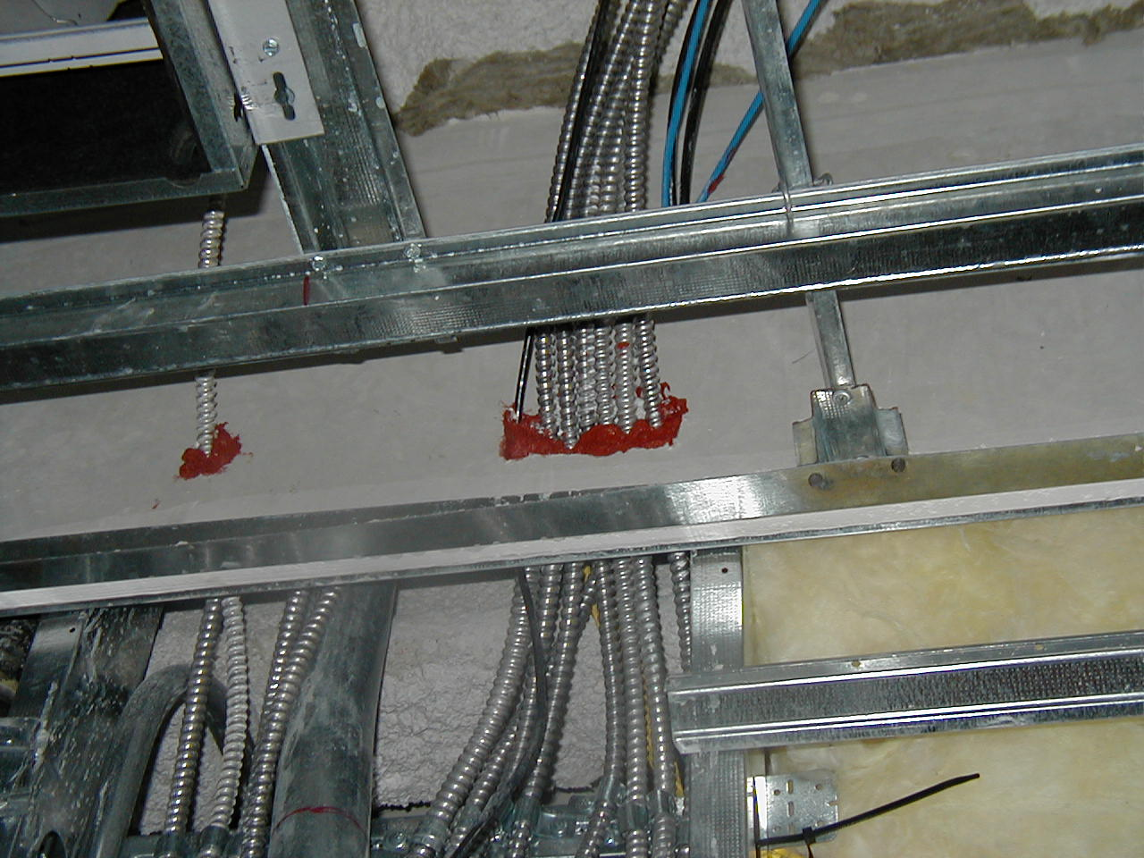

Slide 83
7.1 Type AC Cables, Boxes and Fittings
Cable splices and terminations must be made in a box or other suitable fitting
Connectors or fittings must protect conductors from abrasion unless the design of the outlet box or fitting provides the required protection.
Fittings with direct-bearing screws are suitable for steel armor only
Insulating bushings are required

Slide 84
7.2 Isolated Equipment Grounding
Type AC cable with an insulated equipment grounding conductor is suitable for isolated grounding circuits
Armor provides one path and insulated conductor provides the second
Isolated equipment grounding conductor must be terminated properly

Slide 85
7.3 Health Care Facilities
Two independent ground-fault return paths must be provided in patient care areas
One by wiring method
Second by insulated copper equipment grounding conductor
Armor of Type AC cable provides the first path and insulated equipment grounding conductor provides the second path

Slide 86
7.3.1 Emergency Systems in Health Care Facilities
Type AC cable is not generally permitted for emergency system circuits in facilities with critical care areas
No similar rule for other health care facilities
Type AC cables are permitted for emergency system wiring where:
Used in prefabricated medical headwalls
Used in listed office furnishings
Fished into existing walls or ceilings
Where necessary for flexible connections

Slide 87
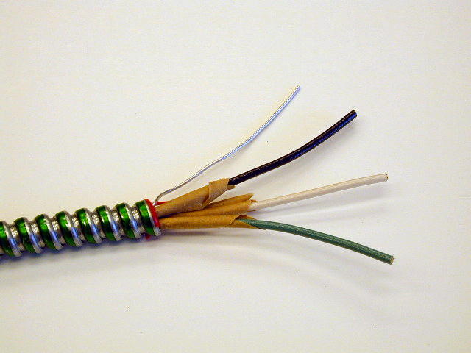
Black insulated wire
Aluminum bond wire
White insulated wire
Green insulated wire

Slide 88
8.1 Type MC Cable, Boxes and Fittings
Cable splices and terminations must be made in a box or other suitable fitting
Connectors or fittings must protect conductors from abrasion unless the design of the outlet box or fitting provides the required protection.
Fittings with direct-bearing screws are suitable for steel armor only
Insulating bushings are not required

Slide 89
8.2 Isolated Equipment Grounding
Type MC cable of smooth or corrugated armor type with an insulated equipment grounding conductor is suitable for isolated grounding circuits
MC cable with spiral interlocked armor requires two insulated equipment grounding conductors
Isolated equipment grounding conductor must be terminated properly

Slide 90
8.3 Health Care Facilities
Two independent ground-fault return paths must be provided in patient care areas
One by wiring method
Second by insulated copper equipment grounding conductor
Armor of the smooth tube or corrugated armor Type MC cable provides the first path and insulated equipment grounding conductor provides the second path

Slide 91
8.3.1 Emergency Systems in Health Care Facilities
See Table 8.3 for identification of Type MC cable permitted for emergency system circuits in hospitals and other facilities with critical care areas or for circuits serving patient care areas
Type MC cables are permitted for emergency system wiring where:
Used in prefabricated medical headwalls
Used in listed office furnishings
Fished into existing walls or ceilings
Where necessary for flexible connections

Slide 92
Table 8.3 Type MC Cable in Patient Care Areas of HCFs
Type of MC Cable | Equipment Grounding Paths | Permitted in Other than Patient Care Areas | Permitted for Patient Care Area Branch Circuits for:
 |  |  | Normal | Critical/Life Safety
MCI | 1. Bare or insulated equipment grounding conductor | Yes | No | No
(MCI-A) | Metal armor with full-size aluminum grounding/bonding conductor Insulated copper equipment grounding conductor not smaller than 12 AWG | Yes | Yes | Yes
See remainder of Table 8.3 on Page 27

Slide 93
8.4 Terminating Type MC Cable (MCI-A)
Cut to appropriate length
Cut the armor using a rotary cutting tool designed for the cable
Separate aluminum grounding/bonding conductor and fold back about 120 degrees
Cut the aluminum grounding/bonding conductor flush with the end of the cable
Select properly sized fitting that is listed for cable
Optionally may terminate aluminum grounding/bonding conductor using proper methods

Slide 94
9. Type MC Cable in Hazardous (Classified) Locations
9.1 Class I Locations
9.2 Class II Locations
9.3 Seals in Hazardous (Classified) Locations

Slide 95
Table 9.1: Hazardous (Classified) Locations
Area or Occupancy | Area Classification | Type of MC Cable
In industrial establishments with restricted public access … | Class I, Div. 1 | MC-HL
See page 30 for Hazardous (Classified) Locations

Slide 96
For Additional Information
www.nacmaonline.com
Any NACMA member company

